Slide 1


Healthcare Analysis
Using SQL and Python

Slide 2


Our team
Anish
Soheb

Slide 3
Objective
To explore and understand the features of the healthcare dataset, including patient demographics and health metrics.
To perform data preprocessing, including handling missing values, outliers, and categorical variables.
To visualize key metrics and relationships in the dataset using various plots.
To segment patients based on health metrics and demographic factors.
To develop predictive models for forecasting cholesterol levels, blood pressure, and BMI categorization.

Slide 4

Scope
Data Exploration: Understanding the dataset, including features such as age, gender, weight, height, blood pressure, heart rate, and cholesterol.
Data Preprocessing: Cleaning the dataset by handling missing values and duplicates, and converting categorical variables into numerical formats.
Exploratory Data Analysis (EDA): Utilizing visualizations like bar plots, scatter plots, and pie charts to illustrate relationships and trends.
Patient Segmentation: Using clustering techniques to categorize patients based on health metrics.
Modeling: Implementing predictive models to assess the likelihood of patients developing high cholesterol and hypertension.
Visualization: Generating charts and graphs to visualize health trends and model results.

Slide 5

Data overview
Patient Demographics:
Health Metrics
Blood Pressure, Heart Rate, Cholesterol Level
Name, Age, Gender, Weight, Height
Calculated Metrics:
BMI

Slide 6

01
Visualization

Slide 7
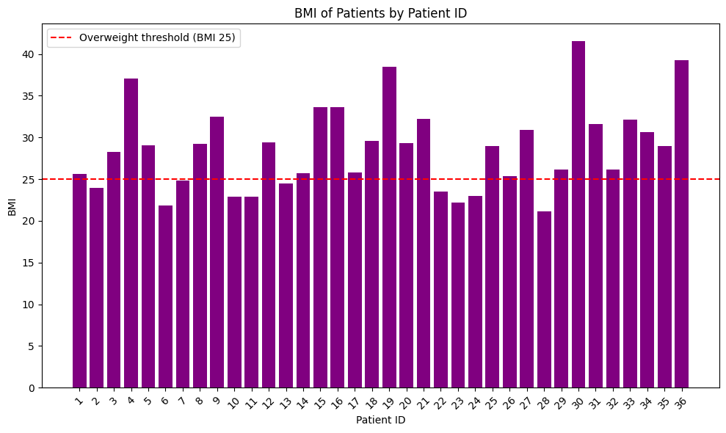
BMI Bar chart

Slide 8
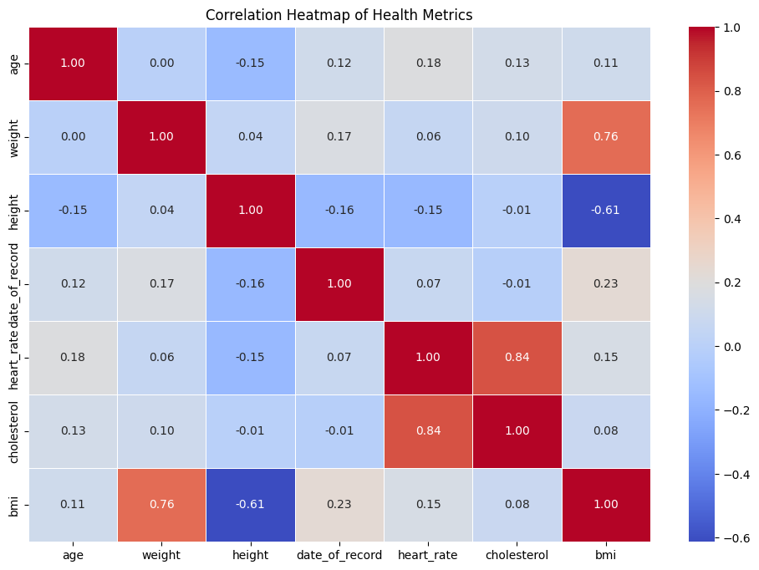
Correlation

Slide 9
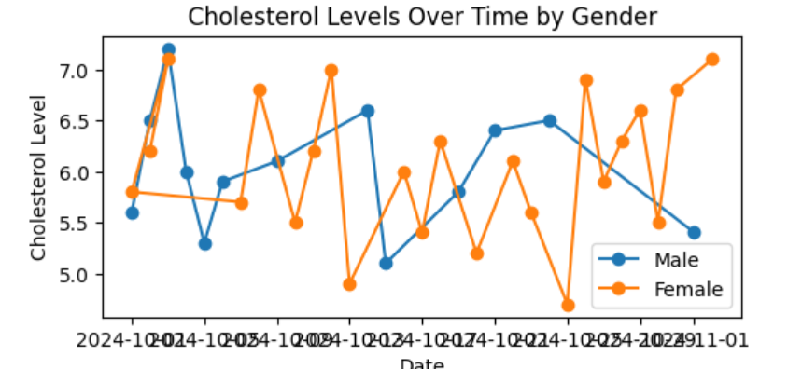
BMI Bar chart

Slide 10
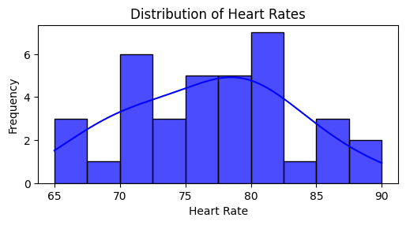
BMI Bar chart

Slide 11
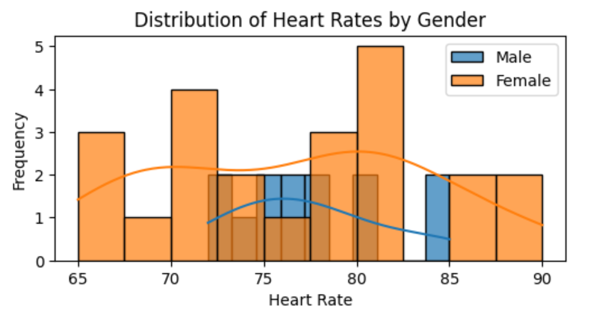
BMI Bar chart

Slide 12
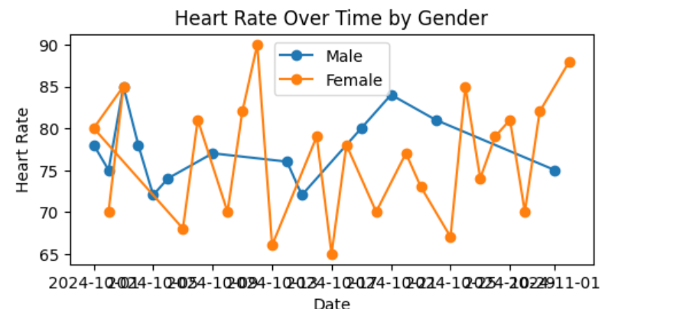
BMI Bar chart

Slide 13
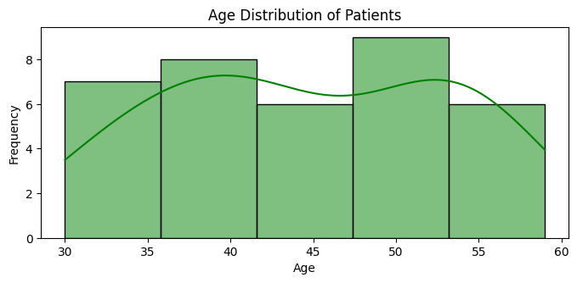
BMI Bar chart

Slide 14
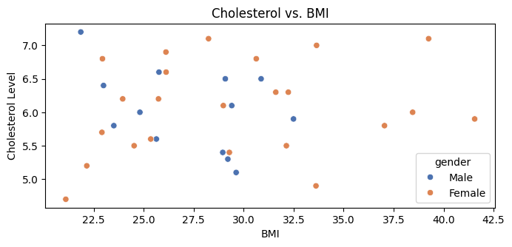
BMI Bar chart

Slide 15
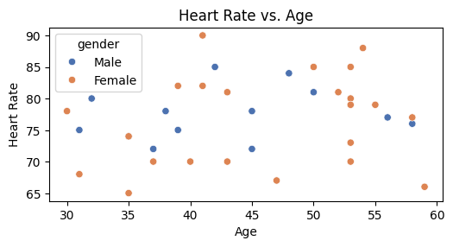
BMI Bar chart

Slide 16
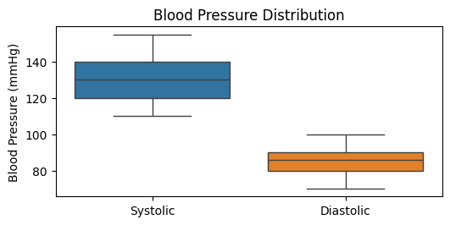
BMI Bar chart

Slide 17
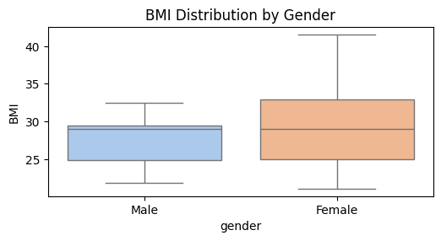
BMI Bar chart

Slide 18
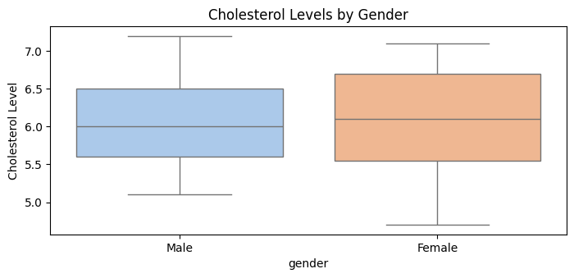
BMI Bar chart

Slide 19
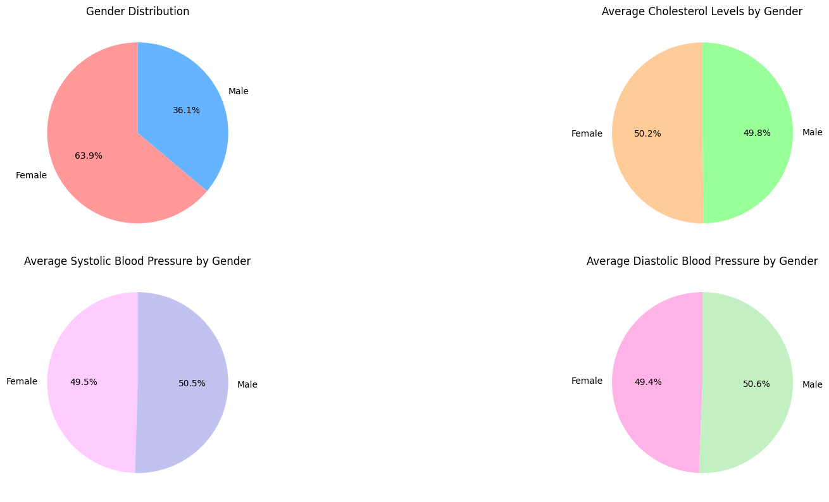
BMI Bar chart

Slide 20
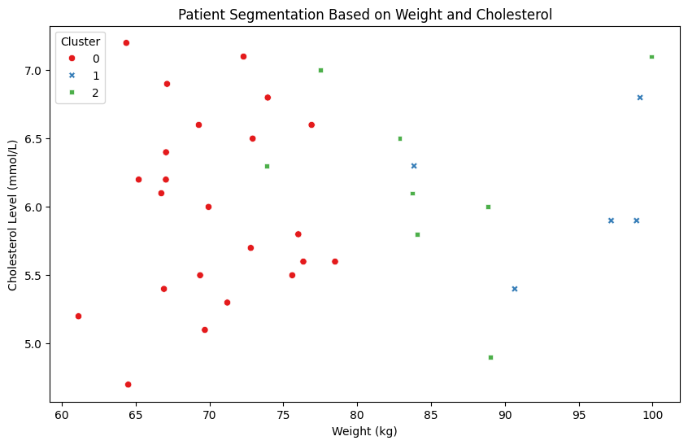
BMI Bar chart

Slide 21
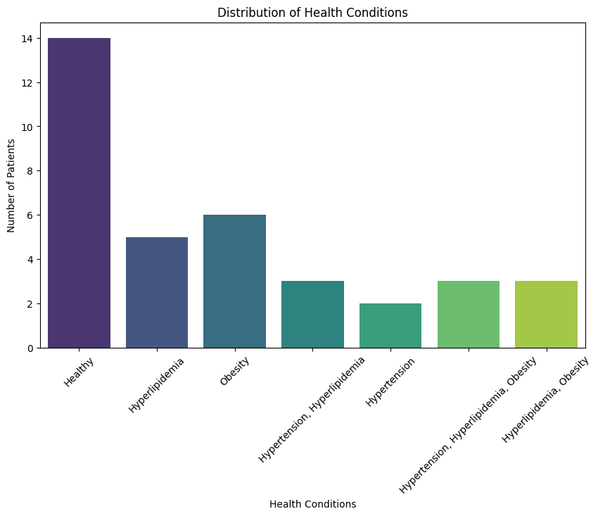
BMI Bar chart

Slide 22

Result

Slide 23

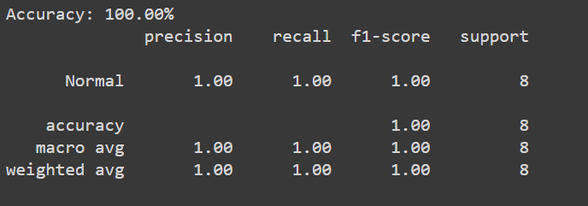
Using RandomForest

Slide 24
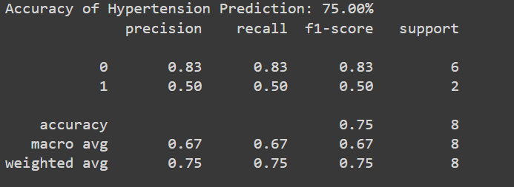
Hypertension Prediction Using Logistic Regression

Slide 25
Conclusion
Defined Thresholds
Hypertension, hyperlipidemia, obesity.
Effectiveness of Analysis
Utilizing health metrics to infer potential risks.

Slide 26

Thanks

